Slide 1
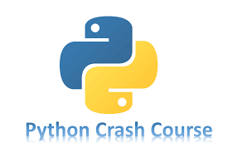

Slide 2
Chapter 10
FILES AND EXCEPTIONS
Brief Summary of Chapter 10
In this chapter, we will explore file handling and exceptions in Python, which are essential for managing and processing data effectively. Files allow programs to store information permanently, while exceptions help handle errors smoothly, preventing the program from crashing. We will cover key topics such as Reading from a File and Writing to a File, which demonstrate how to interact with external files for data input and output. Additionally, we will learn about Exceptions, which allow us to manage errors and unexpected situations in the code, ensuring smooth execution. Lastly, we will dive into Storing Data, using techniques like the json module to save and retrieve user input across program runs.

Slide 3
Reading from a File
To read from a file in Python, you typically use the `read_text()` method from the `pathlib` module, which allows you to open and read the entire contents of a file as a string. The `pathlib` module helps handle file paths in a way that works across different operating systems. When you use `read_text()`, the file's contents are returned as a string, which you can store in a variable (e.g., `contents`). For example, if you're working with a file containing digits of pi, the content could include numbers like "3.1415926535," where "pi" refers to the mathematical constant representing the ratio of a circle's circumference to its diameter. To handle file paths, there are two types: relative and absolute. A relative file path specifies the location of a file relative to the directory where your Python script is stored, while an absolute file path gives the full location, starting from the root of the file system.
When working with files, you often want to process the file line by line, especially if the file contains large amounts of data or structured information. You can use the `splitlines()` method to break the contents of a file into individual lines, which are stored as elements of a list. Each item in this list is a string representing one line from the file, and you can loop through these lines with a `for` loop to access or modify the data. For example, if you're processing weather data or reading digits from pi, you would iterate over these lines to look for specific patterns or perform analysis on the text. By accessing file lines, you can manipulate data more effectively, such as finding a specific piece of information like a birthday in the digits of pi.

Slide 4
File Handling and Data Analysis in Python
Creating the pi_digits.txt File - Page 184
Create a Python Script file_reader.py - Page 185 - 187
Create a Python Script pi_string.py - Page 187
Create a Python Script pi_birthday.py - Page 189

Slide 5
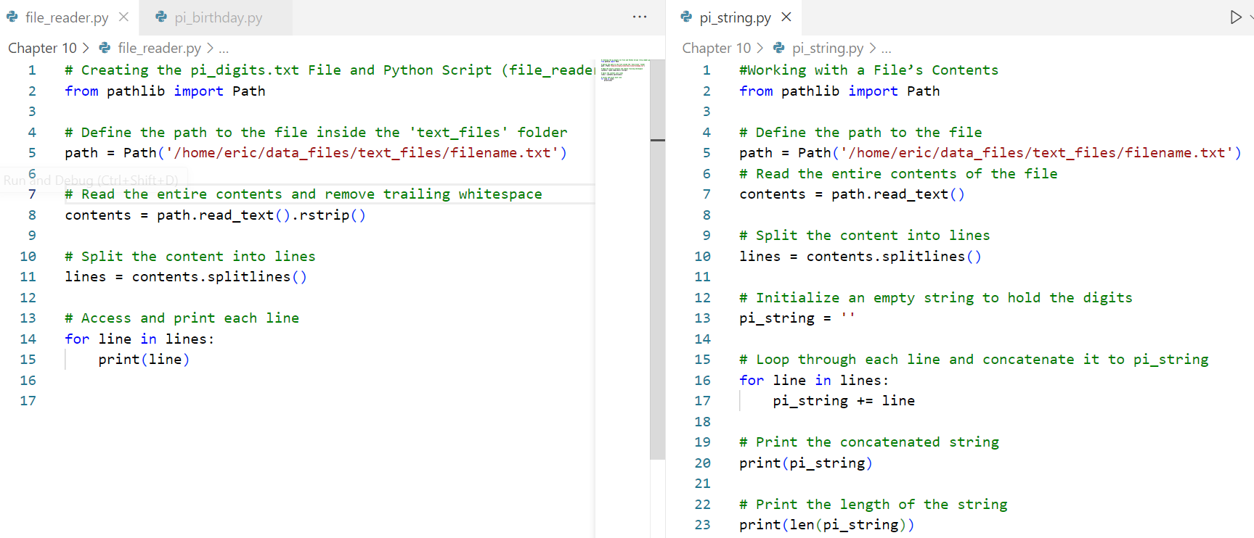

Slide 6
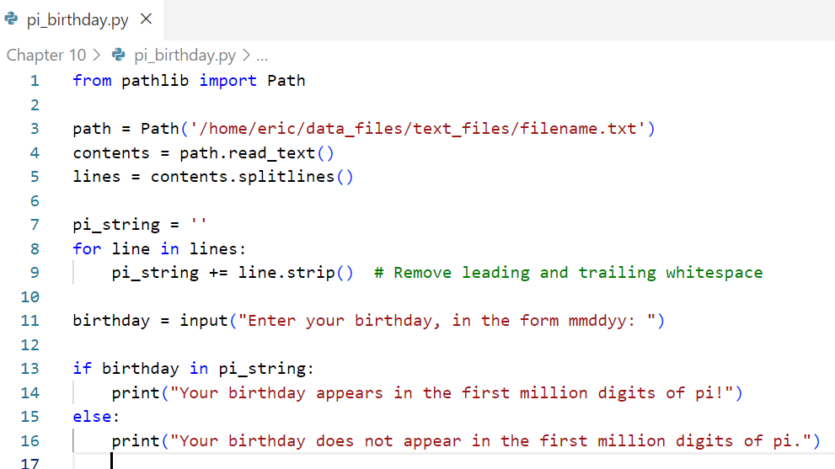

Slide 7
Writing to a File
In this topic, we will be covering how to write data to a file in Python using the write_text() method from the pathlib module. We will explore how to write a single line of text to a file and how to write multiple lines by building a string with newline characters. We will also discuss how to append multiple lines to a file and the importance of proper file handling, such as ensuring the file is closed after writing. Additionally, we will touch on handling text formatting and caution about overwriting files when using write_text(). The main function you'll use is write_text(), and we'll also look at how to build content by adding strings together using the += operator before writing it to a file.

Slide 8
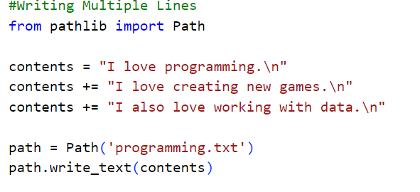
Writing Multiple Lines (Page 191)

Slide 9
Exceptions
Exceptions in programming is catching mistakes before they cause a problem, similar to how a safety net catches a performer if they fall during a show. In Python, exceptions are handled using try-except blocks, which let you expect possible errors and decide what to do if something goes wrong. For example, the FileNotFoundError exception happens when a file is missing, and with a try-except block, you can handle this error instead of letting the program crash. If you're analyzing text from a file and the file is missing, the program can show a helpful message instead of stopping, making sure the program keeps running smoothly.
The (encoding='utf-8') specifies that Python should read or write the file using the UTF-8 (Unicode Transformation Format) character encoding, which supports a wide range of characters from different languages and symbols.

Slide 10
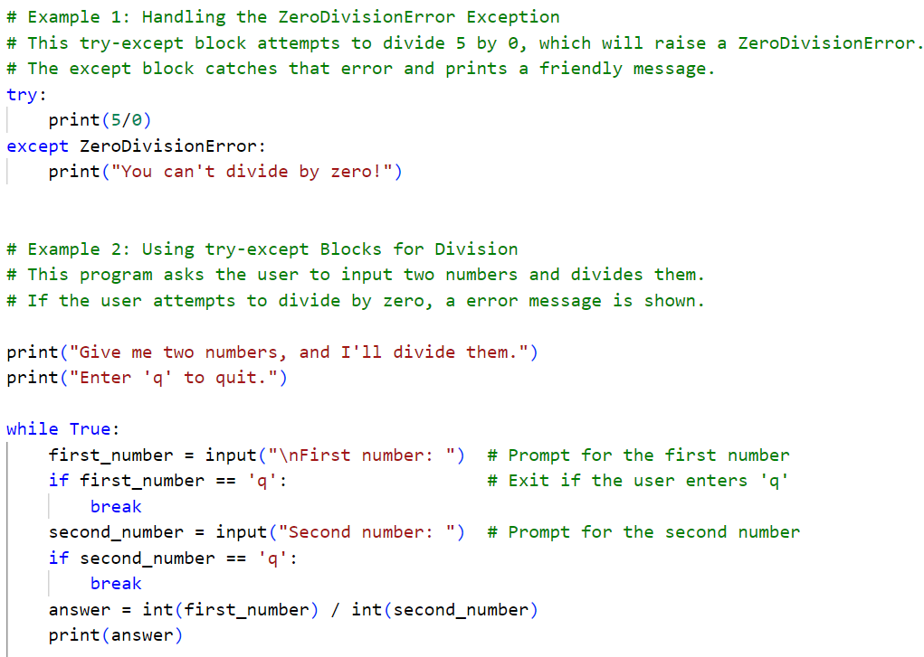
Page 193

Slide 11
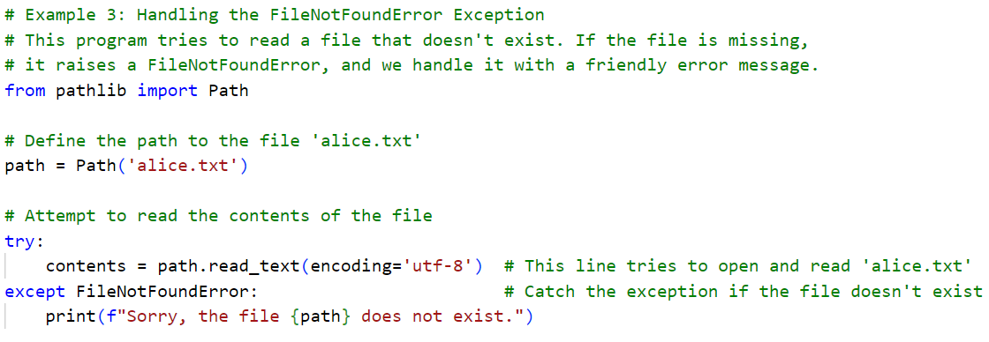
Page 196

Slide 12
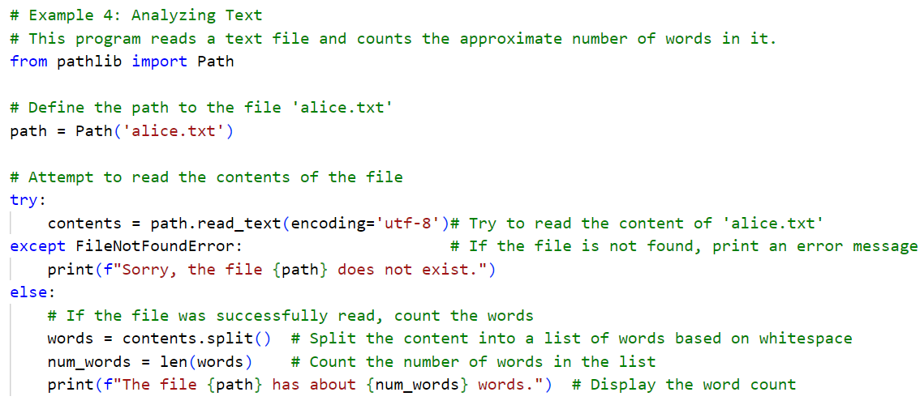
Page 197

Slide 13
Storing Data
JSON (JavaScript Object Notation) is a text-based data format used to store and exchange data. It’s widely used across various programming languages, including Python. The json.dumps() function converts Python objects like lists or dictionaries into JSON-formatted strings, making it easier to store or transmit data in a standard format. On the other hand, json.loads() takes a JSON-formatted string and converts it back into a Python object. User-generated data refers to information provided by users during their interaction with a program, such as names, preferences, or choices, which programs often need to save for later use. Using JSON, this data can be stored and retrieved, ensuring the program retains user input even after it’s closed and reopened.

Slide 14
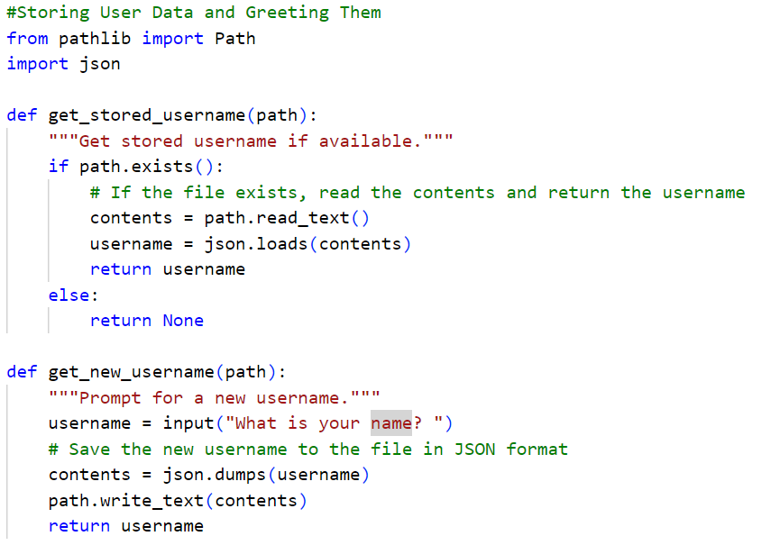

Slide 15
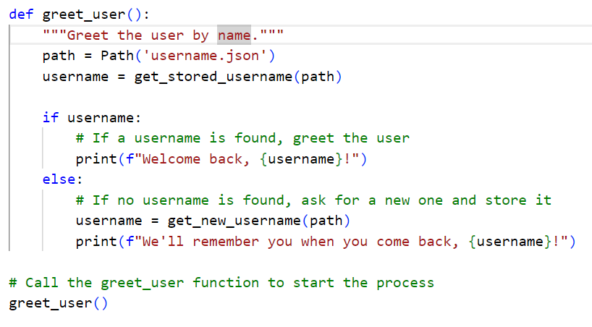

Slide 16
Practice Exercises
Do the following TRY IT YOURSELF on pages:
189
192
200
206

Slide 17

End
Of
Chapter 10

